Slide 1
Python for Data Analysis and Visualization – Final Project

Slide 2
Title : Analysis of Popular Baby Names in the US from 2011 to 2019
Name: Preyash Mahendrabhai Patel (000793739)

Slide 3
Introduction
The dataset we are exploring in this presentation is the “Popular Baby Names” dataset, which provides a comprehensive view of baby name trends in the United States from 2011 to 2019. To perform our data analysis and visualization, we have utilized Python’s powerful libraries: Pandas, Matplotlib, and Seaborn.

Slide 4
01
Dataset Exploration

Slide 5
1. Load the dataset into a Pandas dataframe and display the first 10 rows.
We used pandas read_csv() function to load the dataset.
With the use of head() function we displayed the first ten rows.

Slide 6
2. Display the shape of the dataset (i.e. number of rows and columns).
We used shape() function to display the total rows and columns of the data set.
The dataset has 49509 rows and 6 columns.

Slide 7
3. Identify the data types of each column and check for any missing values (number of missing values in each column).
We used the dtypes() function to identify the data types of each column.
To check for missing values in each column, we used the isnull() function, and to display the sum of missing values, we used the sum() function.
We found 0 missing values in each column.

Slide 8
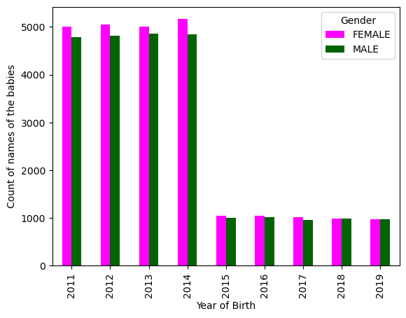
4. Create a bar chart that shows the total number of baby names per year for each gender.
From 2011 to 2014, total number of baby names were higher compared to other remaining years.
Total number of babies significantly dropped from 2015.

Slide 9
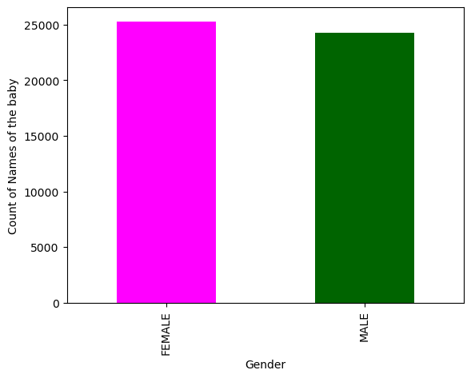
5. Create a bar chart that shows the distribution of names (total number) by gender.
The proportion of Female babies was higher as compared to Male babies across all years.

Slide 10
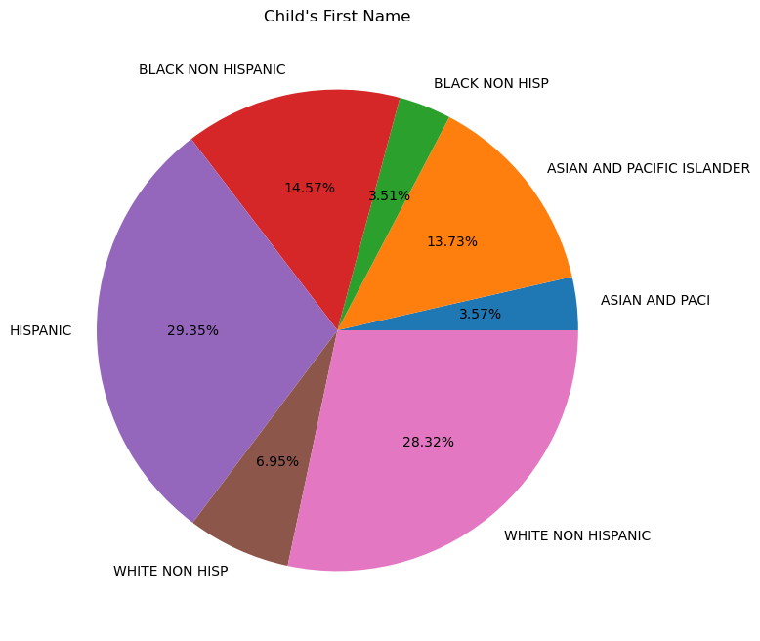
6. Create a pie chart that shows the distribution of names (total number in percent) by ethnicity.
The pie chart reveals the distribution of names by ethnicity.
Vast majority is covered by Hispanic and White Non-Hispanic.
‘Black Non Hisp’ and ‘Asian and Paci’ are minorities.

Slide 11
02
Data Cleaning and Preparation

Slide 12
1. Can you find any duplicated rows in the dataset for the year 2011?
We used duplicated() function and filtered it for the year 2011 to identify any duplicate rows in that year.
There are 7826 duplicate rows for the year 2011.

Slide 13
2. Rename the 'Year of Birth' column to 'Year_of_Birth' and 'Child's First Name' to 'Childs_First_Name'.
We used rename() function to rename the above specified columns.

Slide 14
3. Create a new column that shows the length of each name, excluding any non-alphabetic characters (e.g. spaces or hyphens). Name the new column 'Name_Length’.
We created a user defined function to identify the length of each name and added the output in a new column.

Slide 15
4. Create a new column called 'Percentage' that shows the percentage of babies with each name, based on the total number of babies born in that year and gender.¶
We used groupby() function and transform() function to performe percentage calculation on it and added the output to a new column named ‘percentage’.

Slide 16
5. Replace the ethnic category 'Black or African American Non-Hispanic' with 'Black Non-Hispanic'.
'Black or African American Non-Hispanic' does not exist in the 'Ethnicity' column.
If required, the 'replace()' function can be used to perform this operation.

Slide 17
03
Data Analysis and Visualization

Slide 18
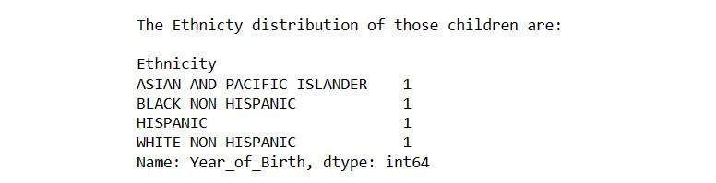
1. How many children were named Jacob in 2018 and what is the ethnicity distribution of those children?
There are 4 children named Jacob in 2018 with different ethnicity.

Slide 19
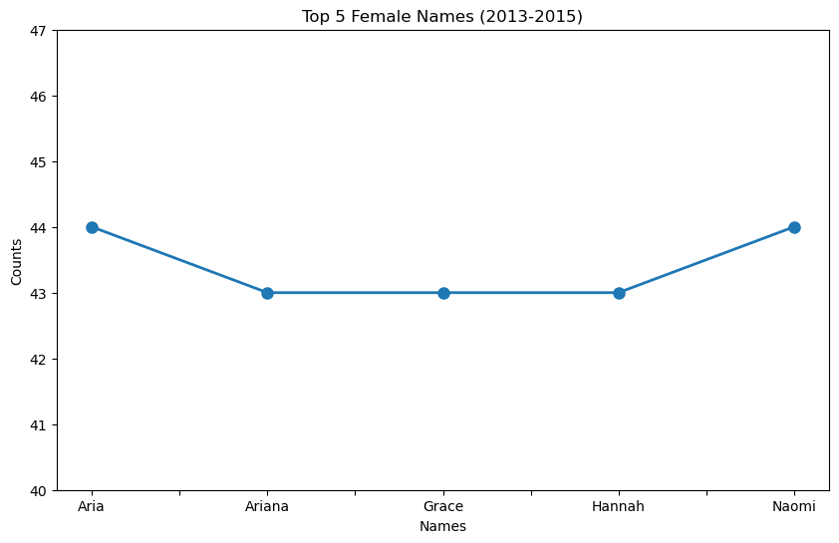
2. Create a line plot that shows the frequency of the top 5 names for the female gender between 2013 and 2015.
The top 5 female names from 2013 to 2015 are: Aria, Ariana, Grace, Hannah and Naomi

Slide 20
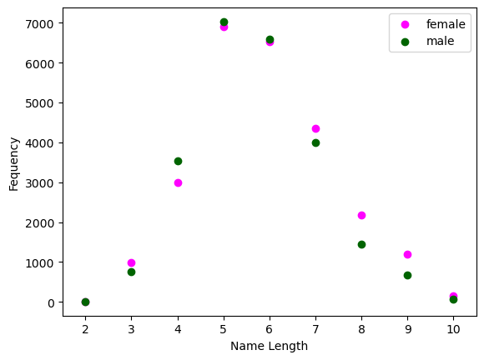
3. What is the relationship between the length of names and their frequency, and how does it differ between genders? The scatter plot should show the length of names on the x-axis, the frequency on the y-axis, and should use color to differentiate between male and female names.
Majority of the babies have name length of 5 characters.
Very small proportion of babies have name length of 2.

Slide 21
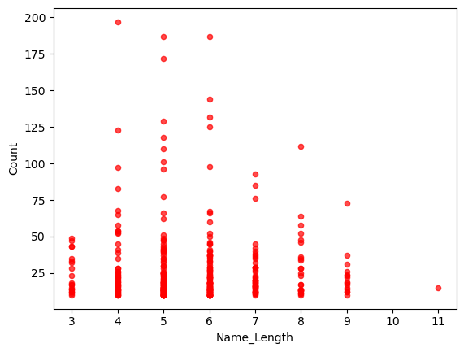
4. Create a scatter plot that shows the correlation between name length and frequency for the 'ASIAN AND PACI' ethnicity. Consider the yearly average count for each name.
The scatter plot confirms that: The data shows a weak negative relationship between Name_Length and Frequency. This means longer names are slightly less common, but the effect is very small.

Slide 22
Recommendation to further improve the dataset
To increase the accuracy of the dataset, removing all the duplicate rows from the whole dataset by keeping the first occurrence and deleting its subsequent.
Also, merging similar naming ethnic groups. For e.g., replacing ‘Black Non-hisp’ with ‘Black Non-Hispanic’ or vice-versa.

Slide 23
Coding Contributions
Section 1: Dataset Exploration – Jacob Prawin Armstrong Raja
Section 2: Data Cleaning and Preparation – Preyash Mahendrabhai Patel
Section 3: Data Analysis and Visualization – Tej Ketan Acharya

Slide 24
Thank You!

